Slide 1
Integration pays off!
Empowerment and visibility
Marte Taylor Bye and Mari Helenedatter Aarbakke
KUN Centre for Gender Equality
Sofia, 15.05.15
Notes:
Introduction:
Good afternoon, and thank you so much for inviting us and allowing us to hold an introduction during this important conference.
My name is Mari Aarbakke, and this is my colleague Marte Taylor Bye. We come from KUN Centre for Gender Equality in Norway. I have a Master in Linguistics and Communication, and have worked a lot with recruitment of men and ethnic minorities to the health care sector. I have also coordinated a successful mentoring network for immigrants. Marte has a Masters degree in social psychology, and has worked with empowering youth, and how to adapt public services to ethnic minorities.
The immigration to Norway is not easily comparable to what you are facing here in Bulgaria. We live far from the heavily strained borders in the south of Europe, and we have a restrictive immigrant policy. Our small population is spread all across Norway, and many district municipalities need immigration to keep up their population. We also need to import many types of labour to perform important tasks in society. Yet we have a right-wing government and growing suspicion against immigrants. What we probably share with you is the challenge of making both the public and the authorities aware of the resources that immigrants represent, and what we need to do to integrate them into society. Therefore, we spend a lot of our time repeating that «integration pays off». We say it to the authorities, the municipalities, and to civil organisations – and we point out that it pays off both in terms of money, welfare, happyness, diversity and humanity.

Slide 2
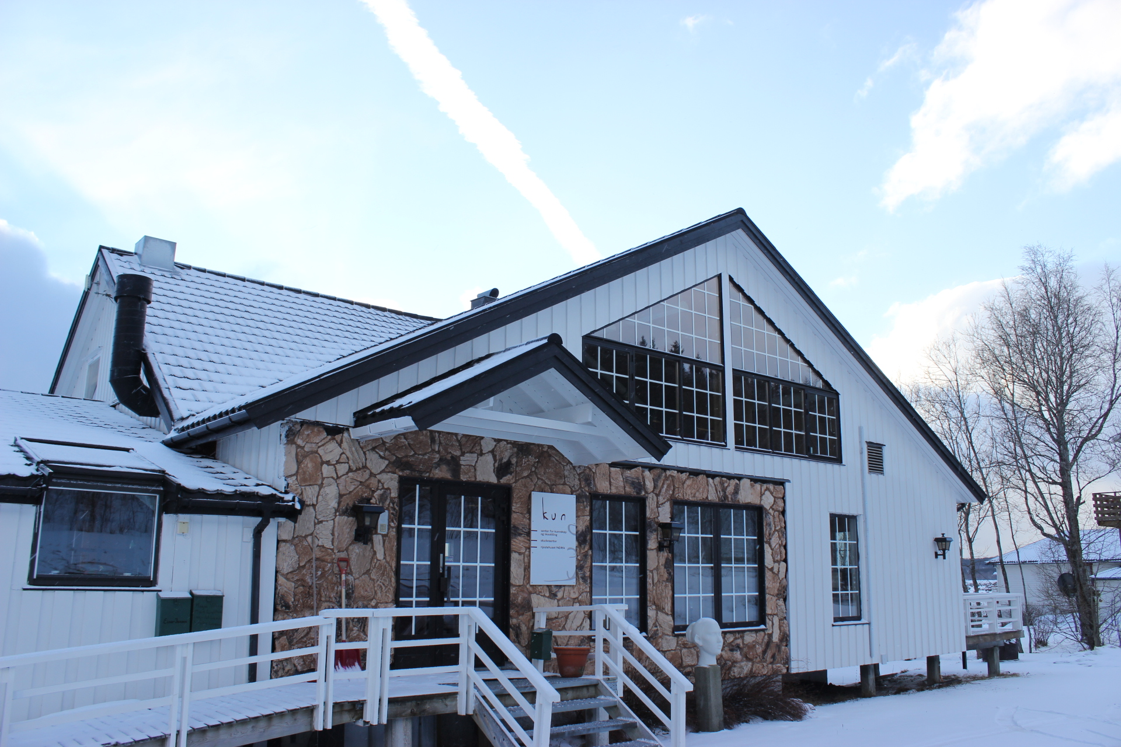
KUN Centre for Gender Equality
Notes:
We are a Non-profit foundation since 1991
We work with equality on all grounds protected by the law: gender, ethnicity, age, sexuality etc. Our work on ethnicity is becoming one of our main activities.
We work with how the system can offer Equal public services to immigrants, and how the individual can qualify for work/education
Goals:
Participation and empowerment
Safeguarding rights

Slide 3
Immigration grounds
Notes:
Statistics Norway-
Biggest group in Norway now is
Work (Europe, Asia, Africa)
followed by family (Europe, Asia)
and asylum (123 000) (Africa, Asia)
These groups have different rights, but many of the same needs. Whereas asylum seekers and immigrants entering for family reunion have the right and obligation to attend language school and introduction program to the Norwegian society, the same is not the case for family establishing , work and education. We still see the need to help these groups as well, their needs are not necessarily covered through their partners or work place.
Some groups have their basic needs met, still we see the need for targeted methods for better integration.
National numbers and rights of the different groups is a basis for working with negative attitudes towards immigrants, among the population in general and among those who provide services to immigrants
Explicit knowledge is key to effective integration.

Slide 4
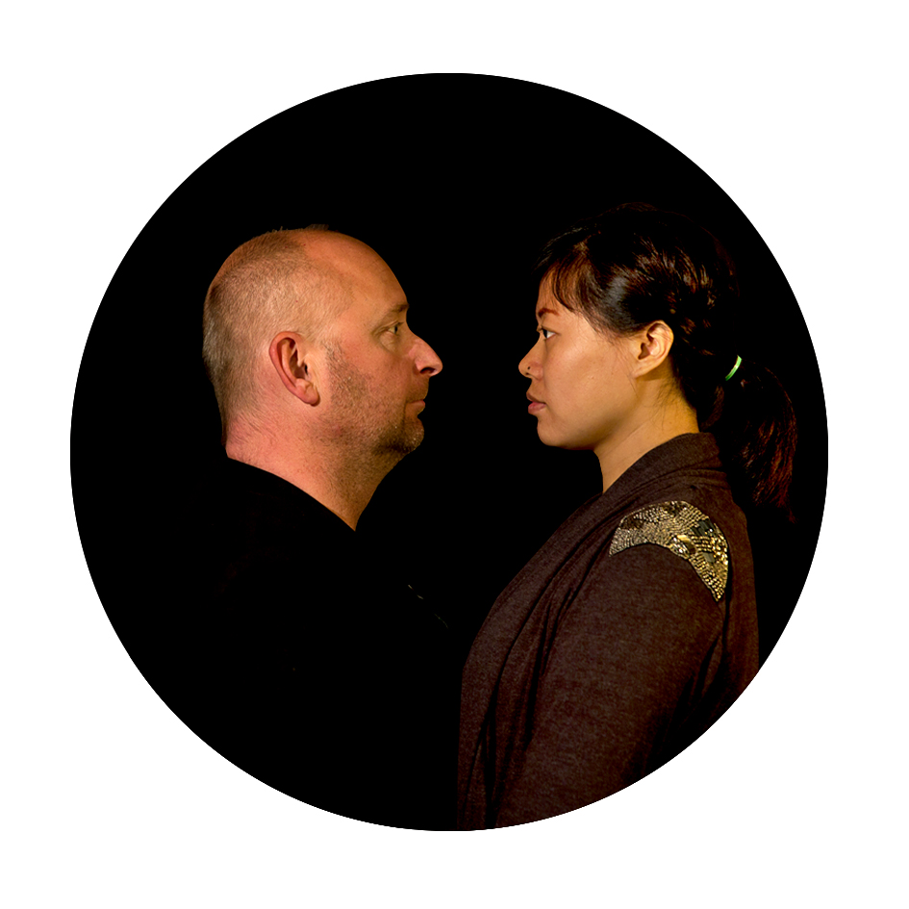
Gathering facts and numbers
Miniature portraits: «Three ways of Framing – Women with and without immigrant background»
Photo: Brynhild Bye-Tiller
Notes:
While there are statisticts on different levels, we often see that translating these numbers to a service level brings valuable additional knowledge. In Ulstein municipality, the health station started to count the births in their region, and found out that 50 per cent of the babies born in the area had one or two parents with an immigrant background. Whereas many people and service providers associate immigration first and foremost with asylum seekers, this count showed how many immigrants there are in the municipality when you include all immigration grounds.
Although the staff at the health station had an idea about the population development, this simple count became an eye opener to the municipality. Following this discovery, discussions involving the planning department, kindergartens and schools- resulted in new plans and targeted measures at the health station-
translation of central information to several languages.
Training for health personnel in intercultural work methods

Slide 5
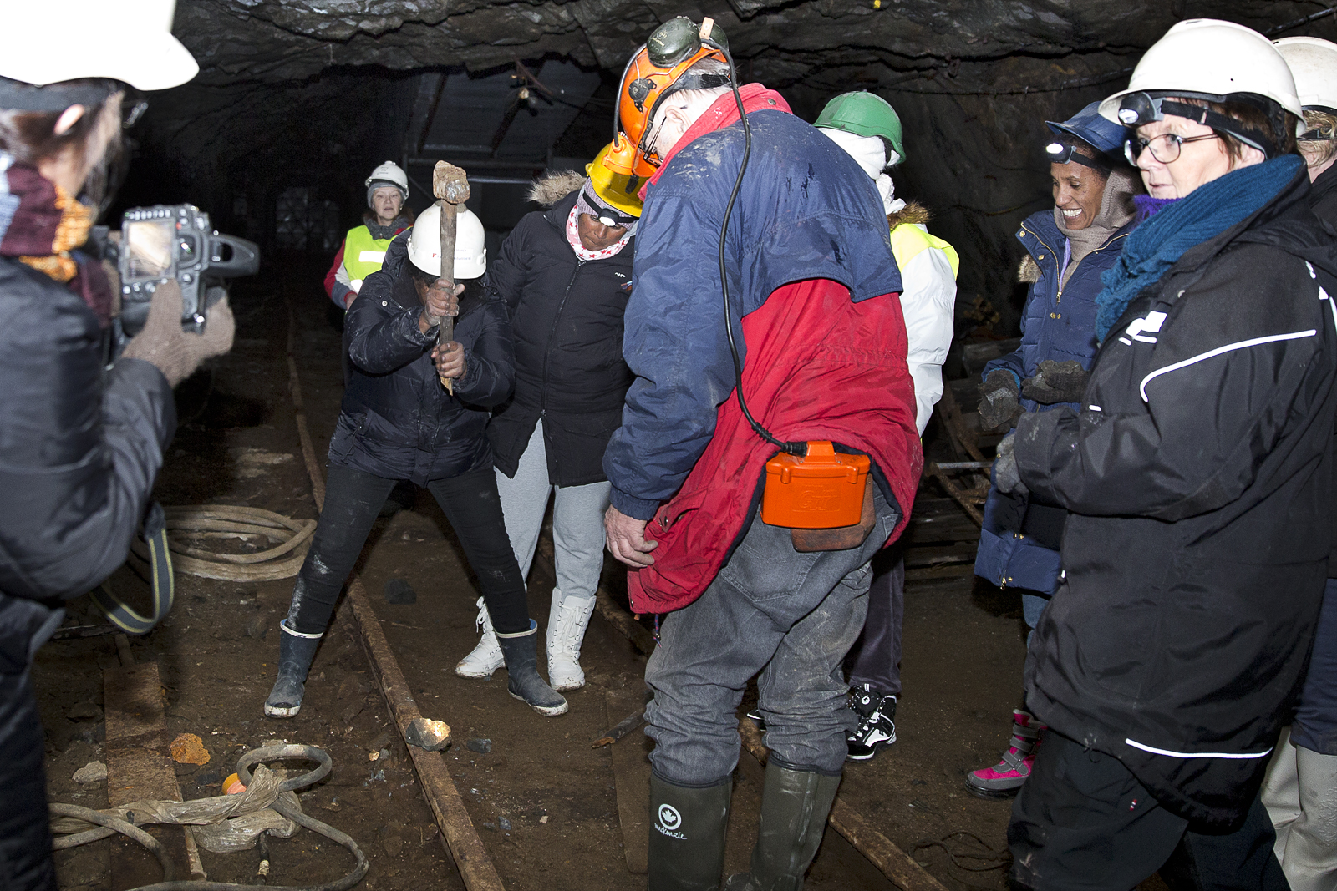
Work life
Excursion to the mine Vestgruven 31.10.2013, as part of the project «Three ways of Framing – Women with and without immigrant background»
Photo: Brynhild Bye-Tiller
Notes:
Unemployment is higher among immigrants than among Norwegians, the unemployment rate being 3,0 in total and 7,5 among immigrants (numbers from Statistics Norway). More men than women with an immigrant background are employed.
Barriers to recruiting international work forces: A foreign sounding name reduces one’s chances of being called to a job interview by 25 %.
One method we employ to work with work life and participation is mentoring programs. These programs take into account that jobs are frequently distributed through netwoks, and that public services often do not have the time to answer all questions and requests from users who are not familiar with the system.
The key to the mentoring programmes is individual guidance and personal investment. Each migrant is paired with a mentor. They meet regurlarly, to discuss matters like formal approval of education and work experience, further education and qualification for further work in Norway.

Slide 6
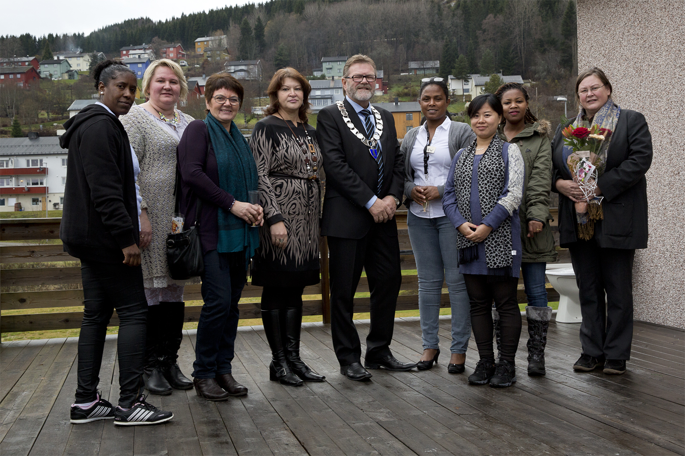
Visibility and participation
Vernissage 02.11. 2013. Participants in the art project «Three ways of Framing – Women with and without immigrant background» Photo: Mads Nordtvedt
Notes:
The pictures you have seen in the last three slides are from an art project where women with immigrant backgrounds participated in art productions in two Norwegian municipalities. Through collaborative work processes resulting in photo exhibitions, the participants became more visible to the society around them, and the art created arenas for building friendship and networks.
The mayor in Verran, one of the participating municipalities, appeared on local television, stating that through the project, the municipality has become aware of the resources and competencies of the participant, helping combat prejudice about female migrants not being qualified nor motivated for work.

Slide 7
Thank you!
www.kun.nl.no
Marte Taylor Bye
mtb@kun.nl.no
Mari Helenedatter Aarbakke
Mari.Aarbakke@kun.nl.no

