Slide 1
Áshildur Linnet - Icelandic Red Cross
Legal assistance to asylum seekers and social integration of refugees

Slide 2
Part 1 - Legal assistance to asylum seekers
Started with a volunteer program from 2009-2011 and advocacy for the right to a legal representation
Red Cross took over all legal representation for asylum seekers in Iceland at administrative level from 25th August 2014
Asylum application per year in Iceland
2013: 172 or 0,5 per 1.000 inhabitants
2014: 174 or 0,5 per 1.000 inhabitants
2015: estimation 230 or 0,7 per 1.000 inhabitants
From 25th August 2014 we have had 136 applicants of 36 different nationalities
Notes:
Key words for translators (not on slides):
Private lawyers
Legislation
Ministry of Interior

Slide 3
Applying for asylum in Iceland
Notes:
Key words for translators (not on slides):
Schengen area / Shengen outpost / Shanegen border control

Slide 4
Other support of the Icelandic Red Cross
Weekly open appointments where people can come and talk about their case, daily life, support they need, family matters, right to work, education etc.
Regular cloth donations
Weekly social activities
Volunteer work
Visitation service – support from volunteers
Restoring family links

Slide 5
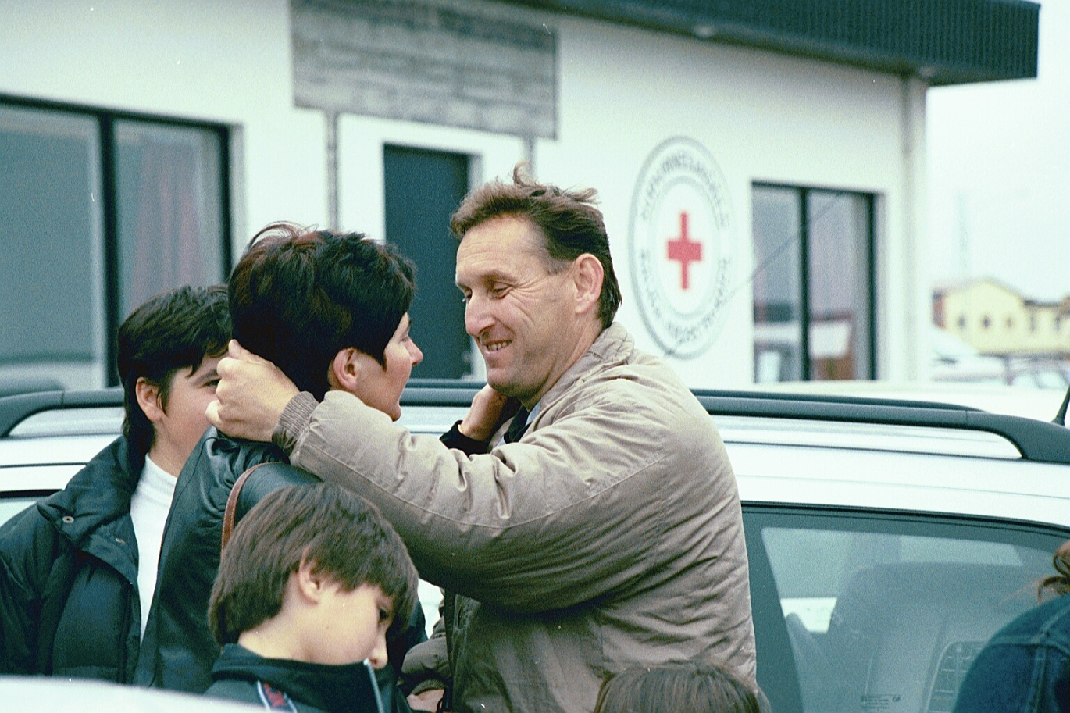
Part 2 – Social integration of refugees
A program run by the Icelandic Red Cross as a formal program from the 1990’s
Part of the Red Cross role in reception of resettled refugees in Iceland in cooperation with the Ministry of Welfare
Based on support families for the refugees
Iceland has focused on resettlement of vulnerable groups like women at risk, LGBTI and medical evacuation
Notes:
Key words for interpreters
The volunteer support for refugees started in late 1970´s
The seven fudamental principles
Advocacy for asylum seekers and refugees in Iceland
Human Rights issues

Slide 6
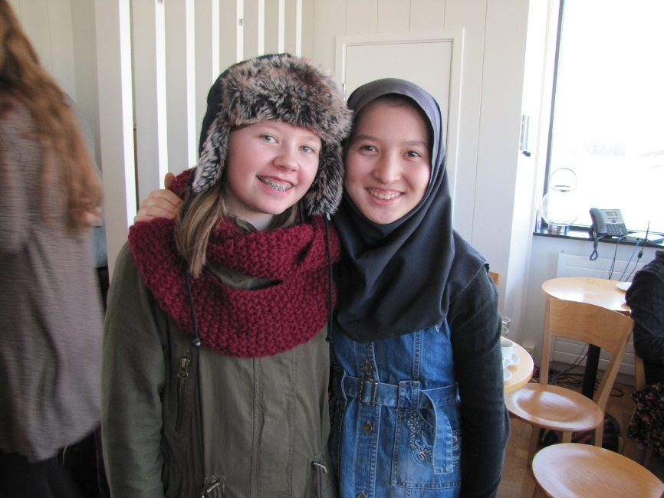
Why do we use family support system?
Important support during the first steps in a new country
Is important factor in social integration
Supports language learning
Promotes cultural understanding
Decreases xenophobia
Raises awareness about refugees
and the worlds refugee situation

Slide 7
Volunteers
Volunteers play a key role
Training and preparation is important
The refugee family gets 4 support families
The volunteer manager supports the volunteer support families during the 12 month program
Language knowledge is not necessary but patience is
Use technology to communicate and organize so the volunteers as a group give the best support
Confidentiality to the family in spite of the longing to share this interesting challenge with your friends

Slide 8
The Refugees
Must have a voice when entering the program
Different people with different needs
Can feel pressure from their fellow countrymen to be ambassadors for their culture and good standards
Have to rely on interpreters for everything during the first months and that can feel like invasion to their private life
Need an opportunity to participate not only to receive

Slide 9
Testimonies
“It was important for me to have the support families. They became my family in times when I had no family. I will be forever grateful for their support. I’m still in contact with one of the families, she is like my aunt that always welcomes me to her home”
A girl that entered the program at the age of 19

Slide 10
Testimonies
“when I first came I felt so welcome. The staff at the hospital helped me so much and all the other support I got was just overwhelming. It made it easier to recover and focus on my health. Two years after I came, when I finished my treatment, I finally had to face my new life without support. It was a bit shocking but the support I got at the beginning helped me to stay focused on the future”
A man that came for medical treatment during the Balkan wars

Slide 11
Testimonies
“I became a volunteer for the Red Cross because my family has always talked about the important support they got from the Red Cross when they came here. It made all the difference for them. This is my way of saying Thank you for the support you gave my grandparents. A support that was the cornerstone to my fathers future. I volunteer to honour my father”
A volunteer who is third generation of Vietnamese boat people

Slide 12
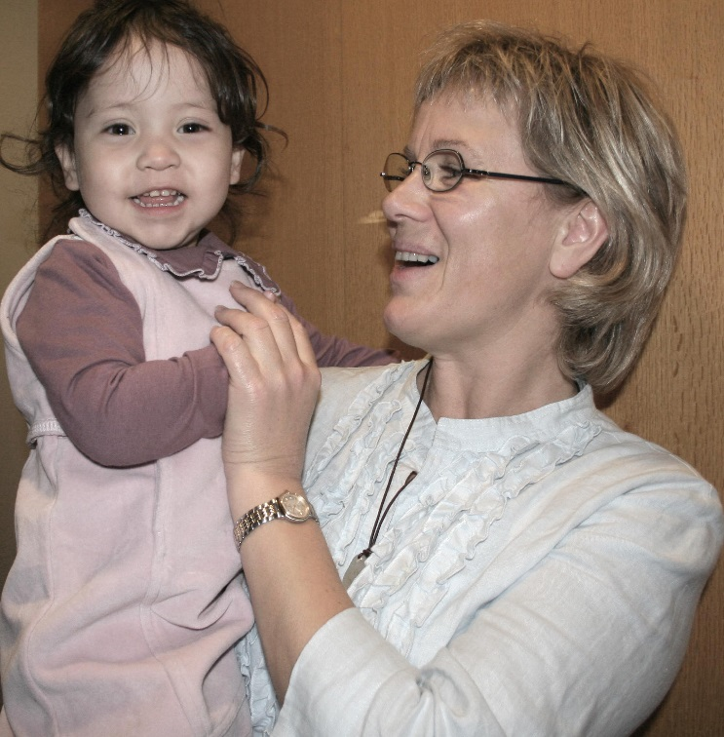
Challanges
Expect the unexpected
All involved being the Ministry, Municipality, Red Cross Staff or volunteers must work together
Take care of your volunteers they need support to be able to support
Prepare for misunderstandings
Be humble and accept you will make mistakes and have the courage to correct them
Notes:
Það er margt sem getur farið úrskeiðis svo þú þarft að vera tilbúinn til að vera sveigjanlegur, vinna á öllum tímum sólahrings í upphafi o.s.frv.
Samstarfið er lykilinn. Ef þeir sem standa að móttökunni vinna ekki saman þá fer þetta ekki vel – það verður að vera skýr verkefnastjórnun
Okkar hlutverk að hugsa vel um sjálfboðaliðana svo að þeir veiti góðan stuðning
Misskilningur verður á alla vegu – fara aðeins yfir það og hversu mikilvægt það er að játa mistök, leiðrétta misskilning og geta haft smá húmor fyrir sjálfum sér. Þetta er samvinnuverkefni allra sem koma að því, okkar, flóttafólksins og sjálfboðaliðanna. Öll munum við standa ríkari upp frá verkefninu og auka á víðsýni okkar.

