Slide 1
The UnBulgarians
A photography project by
Free Speech International Foundation
In partnership with
Multi Kulti Collective
With the support of the NGO Programme in Bulgaria under the Financial Mechanism of the European Economic area 2009-2014

Slide 2
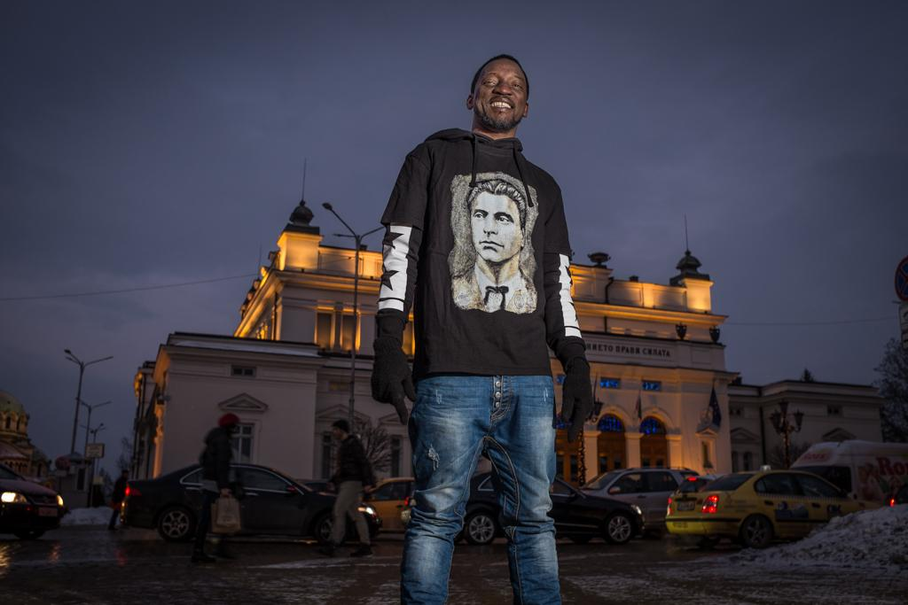
Bamba Mohamed Lamine
Mali

Slide 3
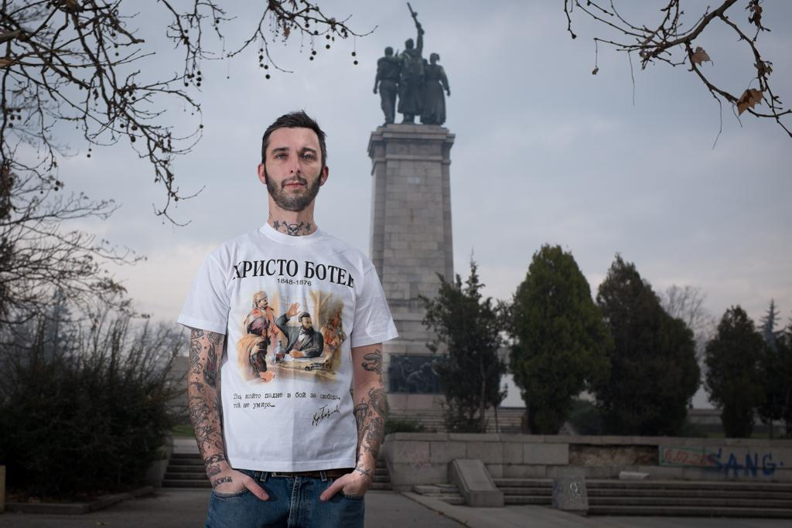
Rorry Miller
USA

Slide 4
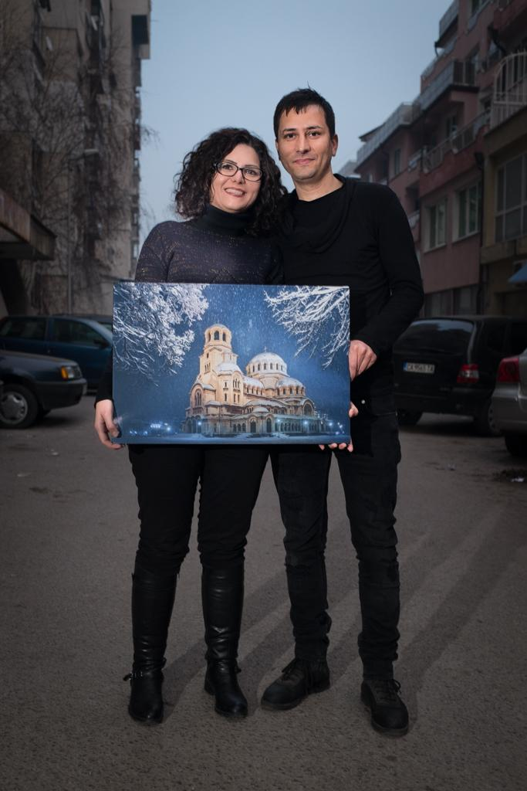
Behrokh Sabounchi
and Mahdi Mosadegpur Iran

Slide 5
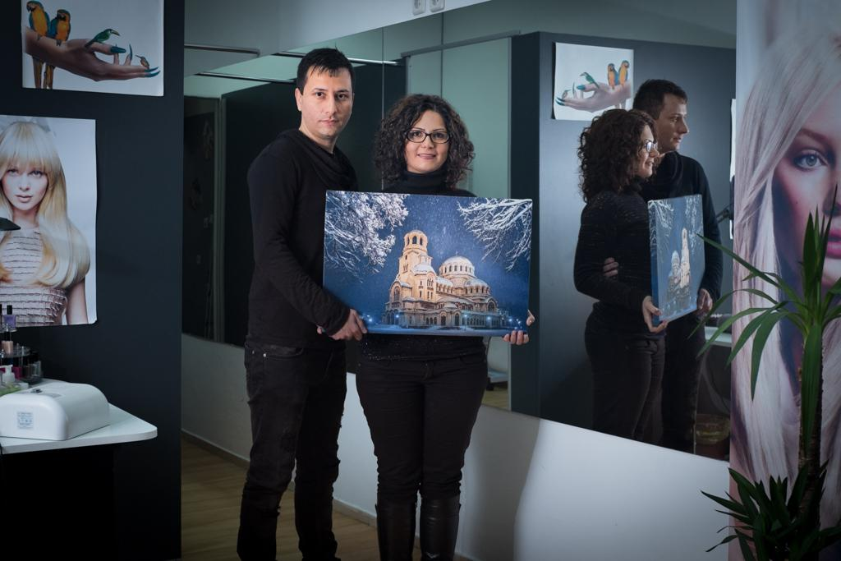

Slide 6
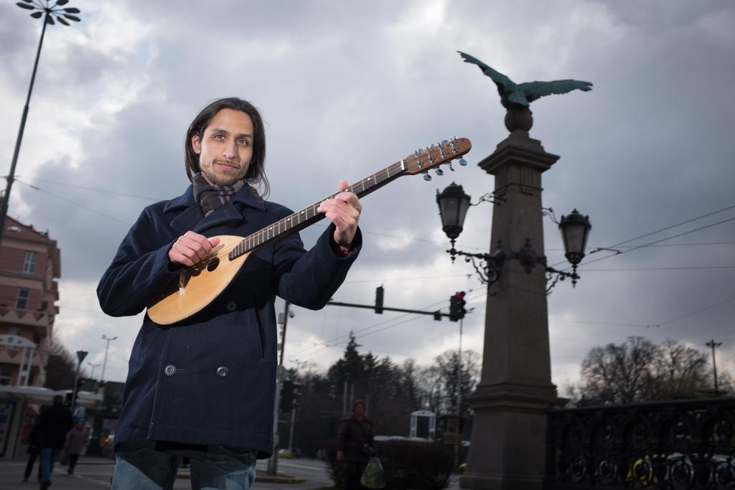
Piero Epifania
Peru

Slide 7
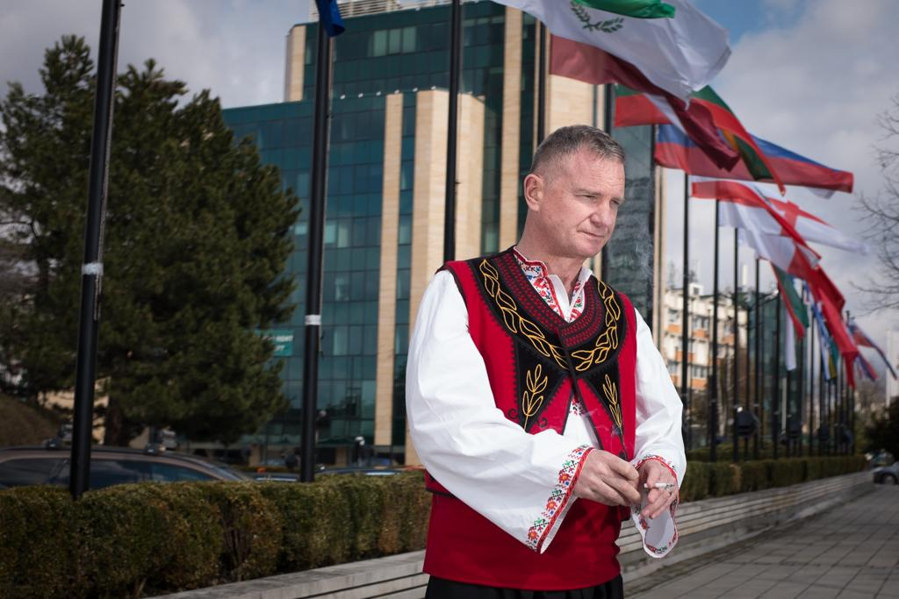
Hugh Frazer
New Zealand

Slide 8
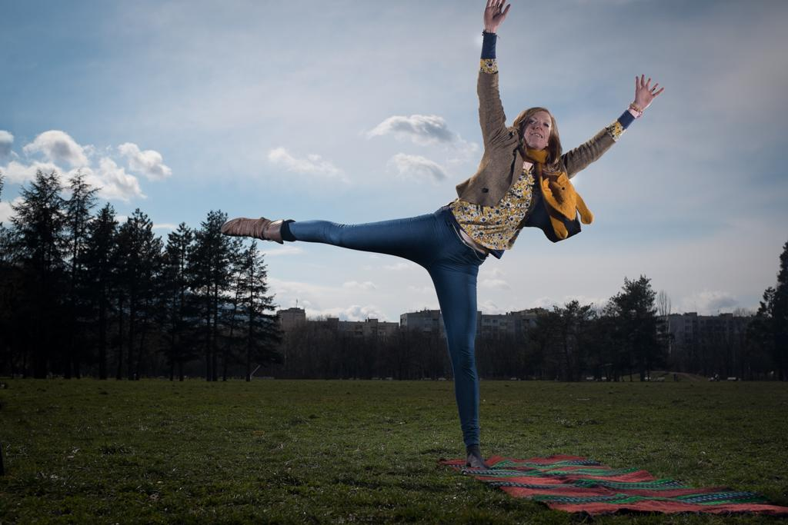
Zoë Holliday
Great Britain

Slide 9
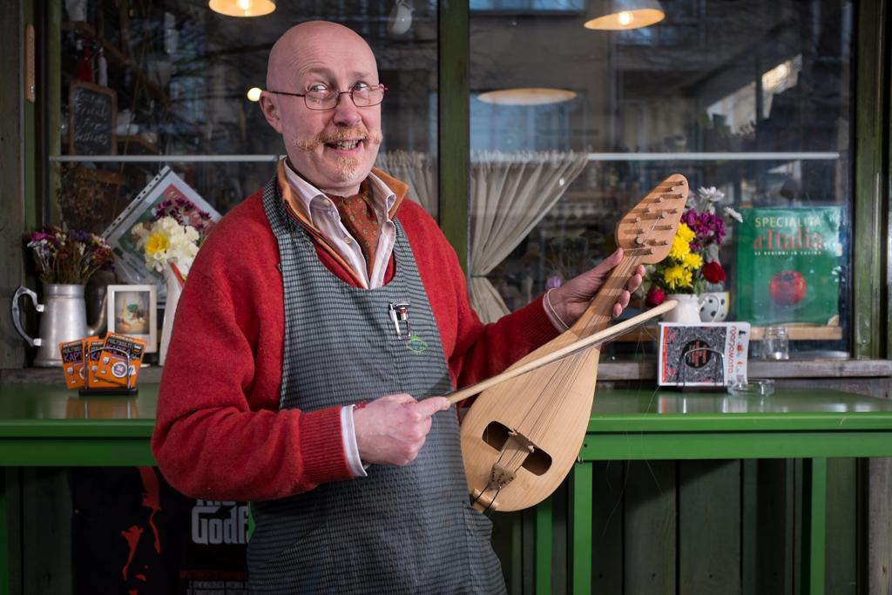
Mario Montesoro
Italy

Slide 10
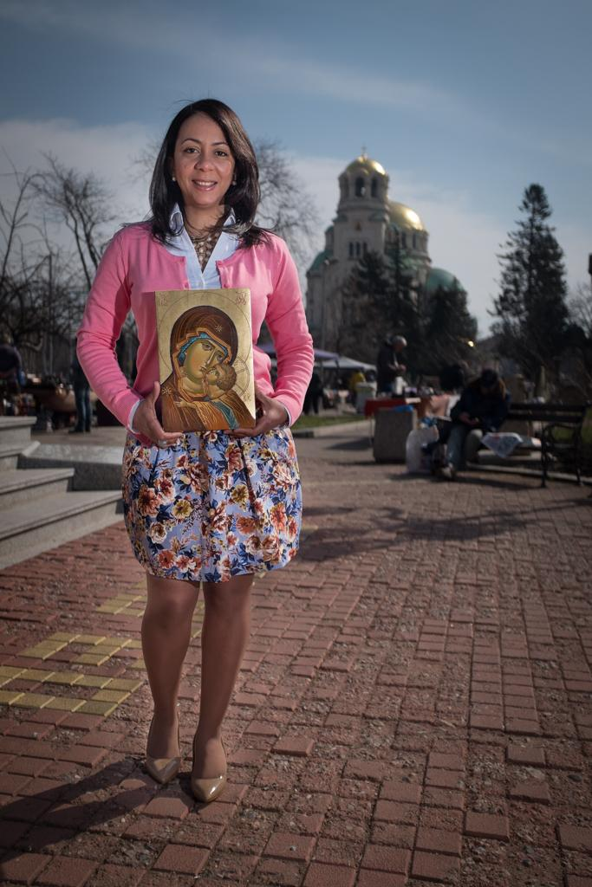
Johanna Alcantara Dominican
Republic

Slide 11
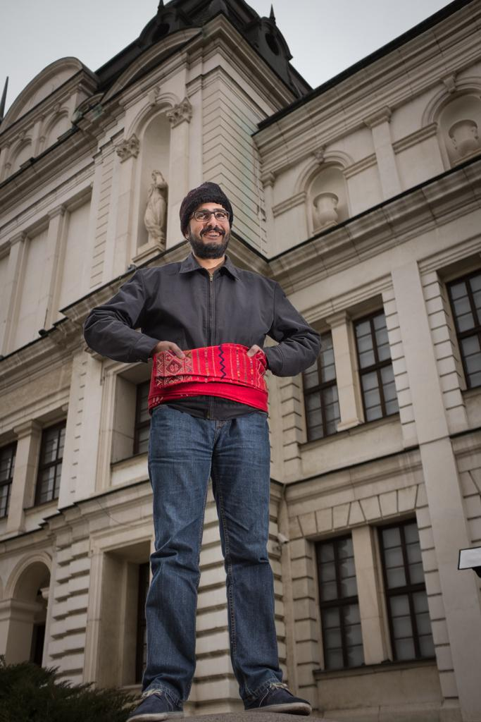
Dafar
Shaban
Iraq

Slide 12
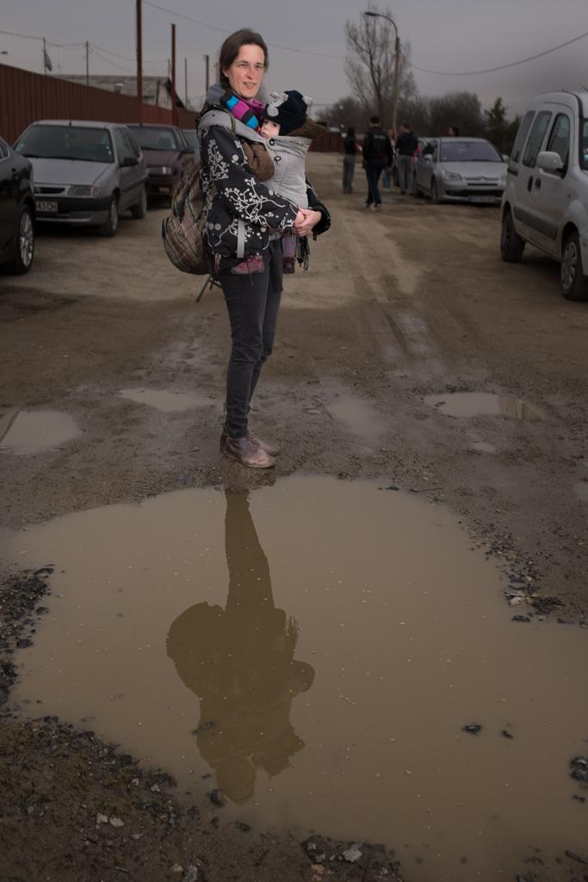
Gwen Schoeters
Belgium

Slide 13
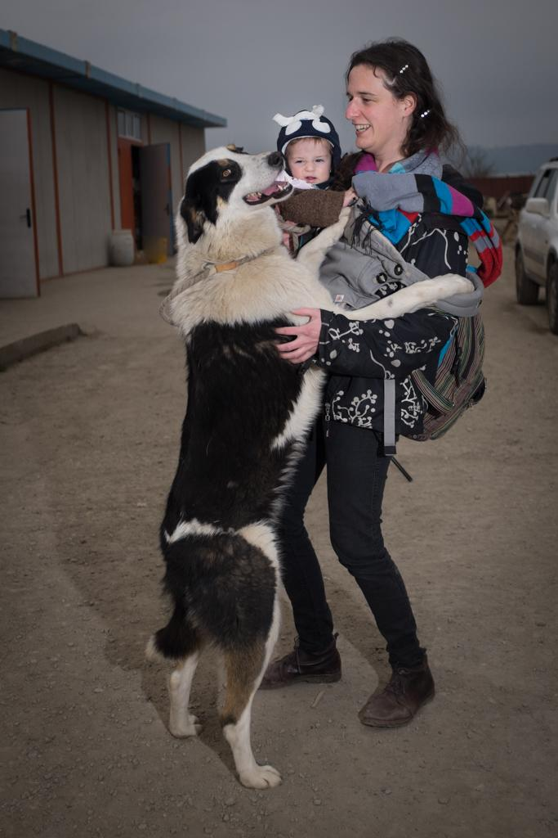

Slide 14
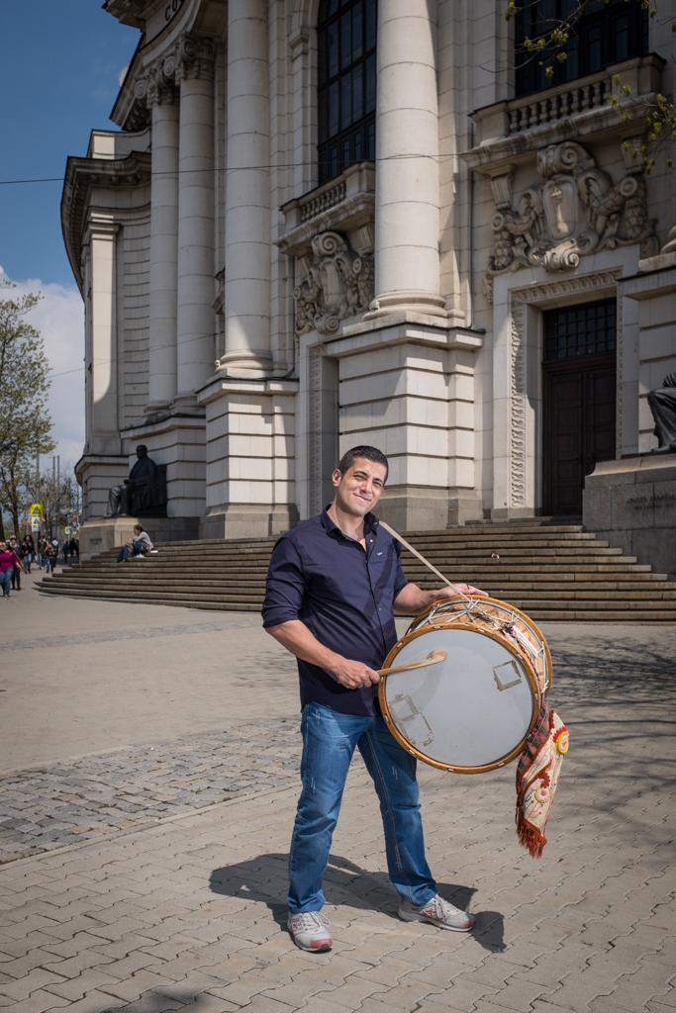
Ehab Mohammed Egypt

Slide 15
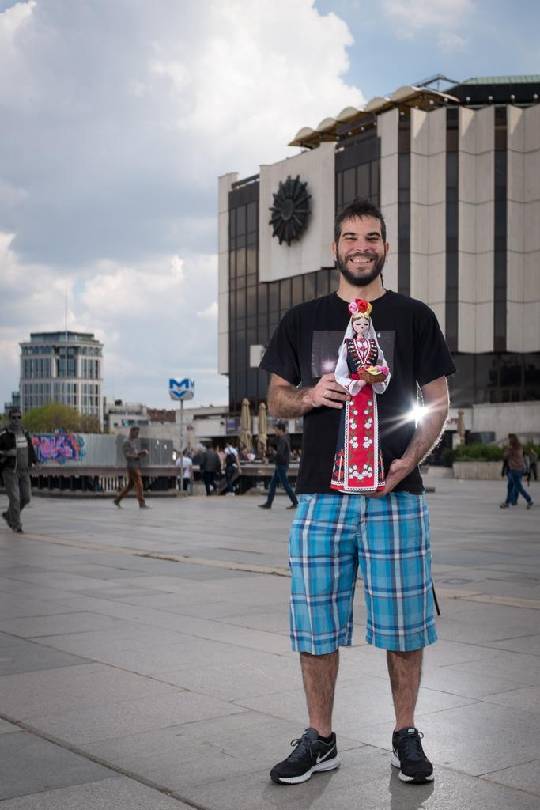
Gustavo Velázquez Venezuela

Slide 16
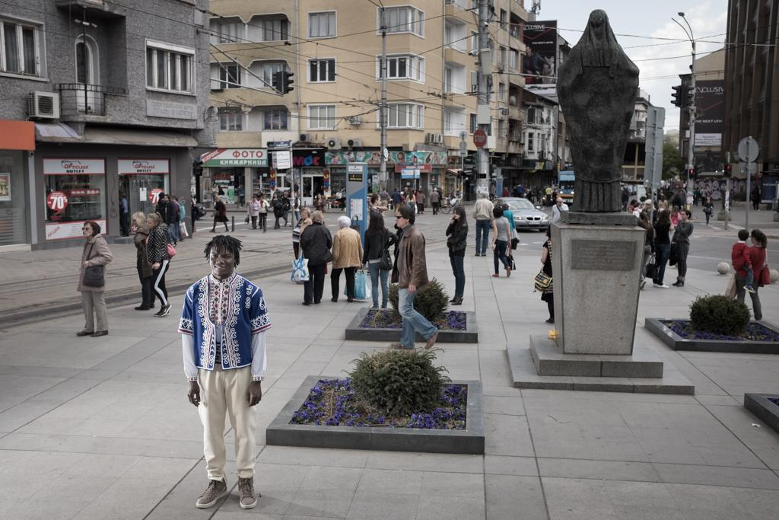
Kone Yaku
Côte d'Ivoire

Slide 17
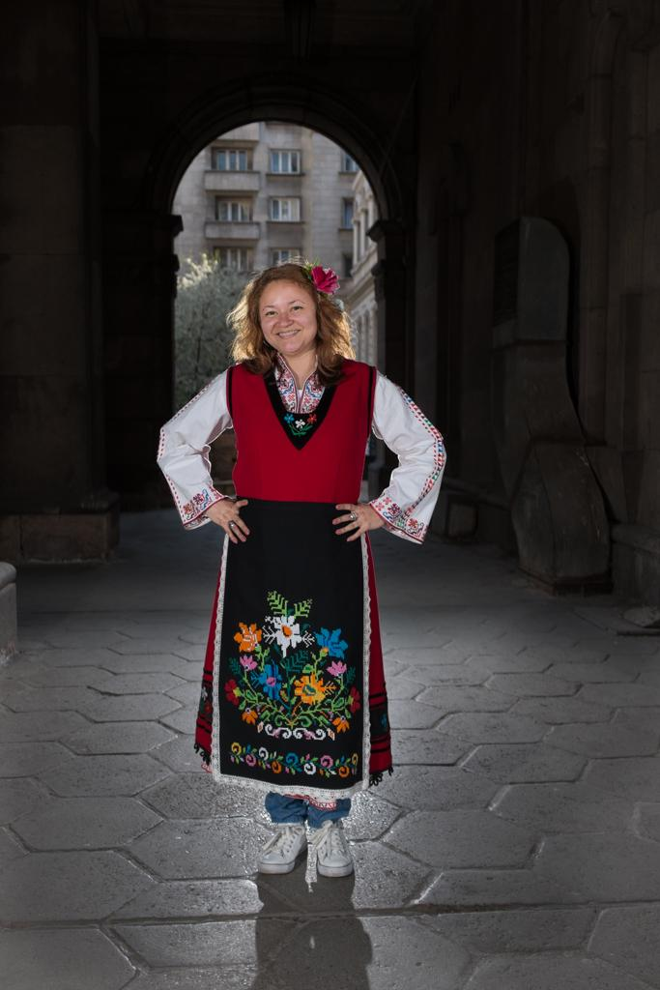
Nora
Obando Nikaragua

Slide 18
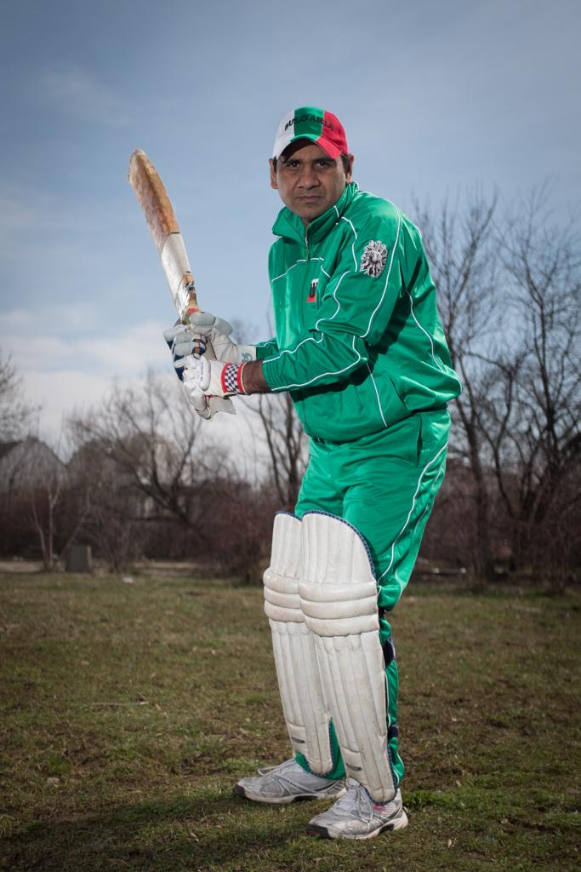
Saif-ur Rehman Pakistan

Slide 19
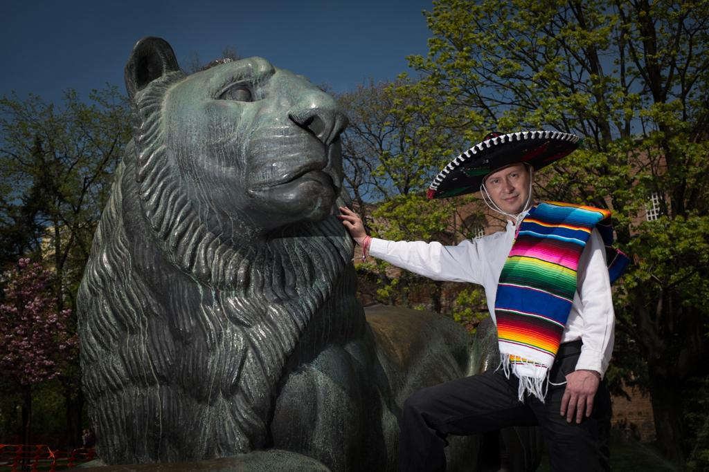
Carlos Arellano
Mexico

Slide 20
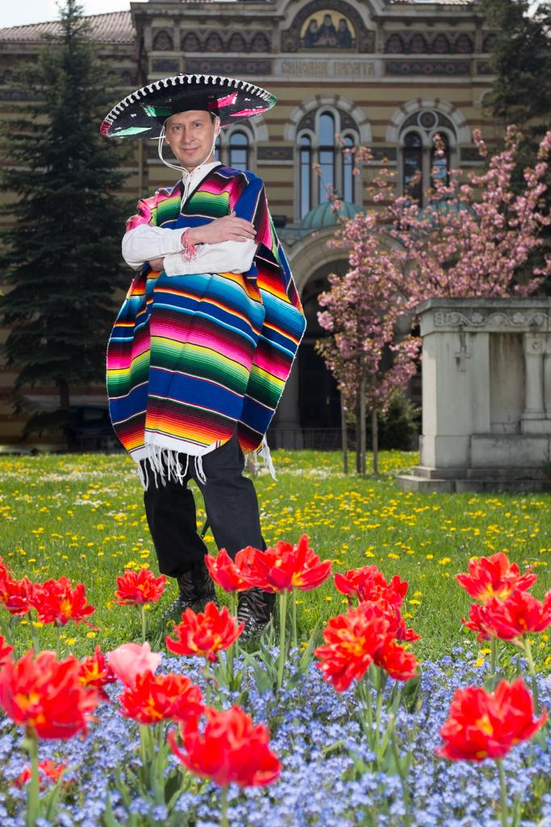

Slide 21
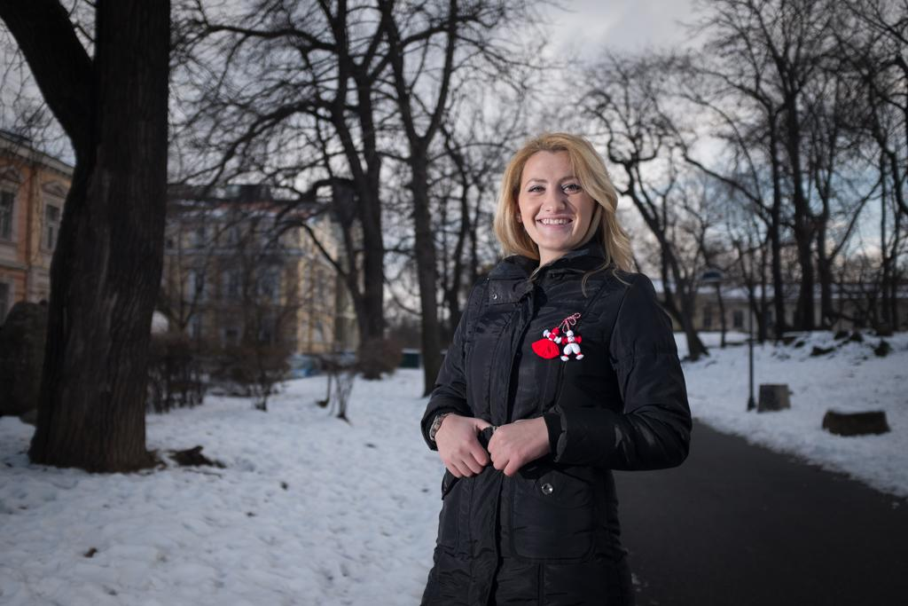
Ehlibejte Mehmetaj
Albania

Slide 22
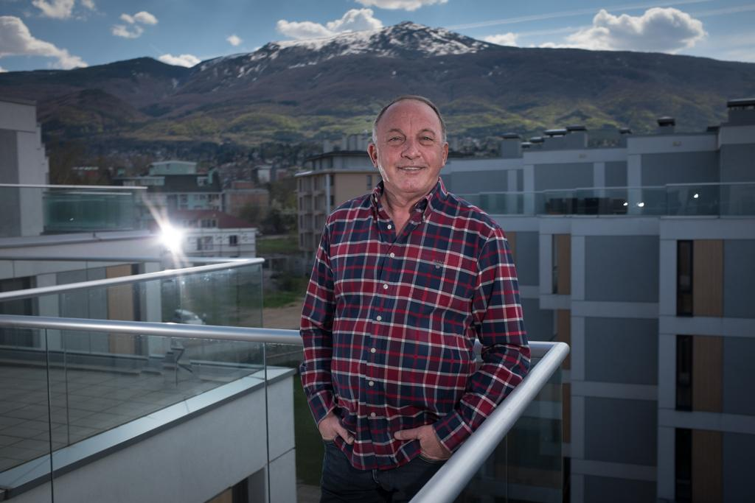
Noah Maayan
Israel

Slide 23
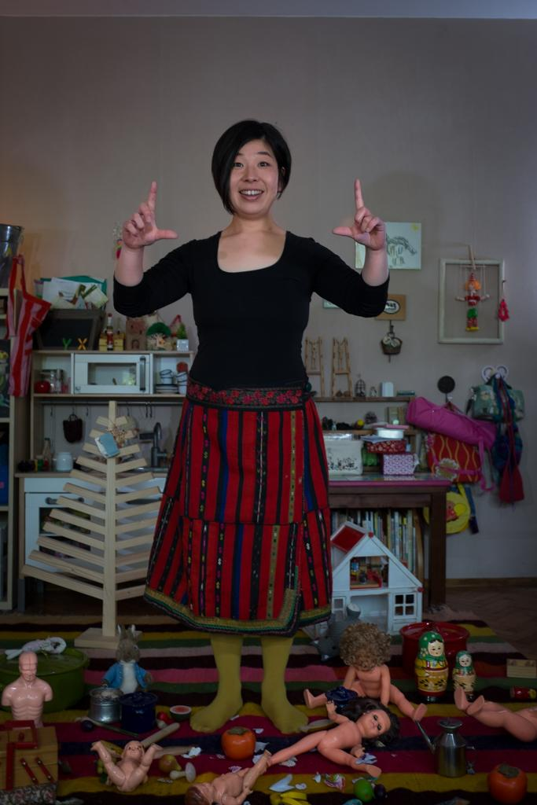
Rin Yamamura
Japan

Slide 24
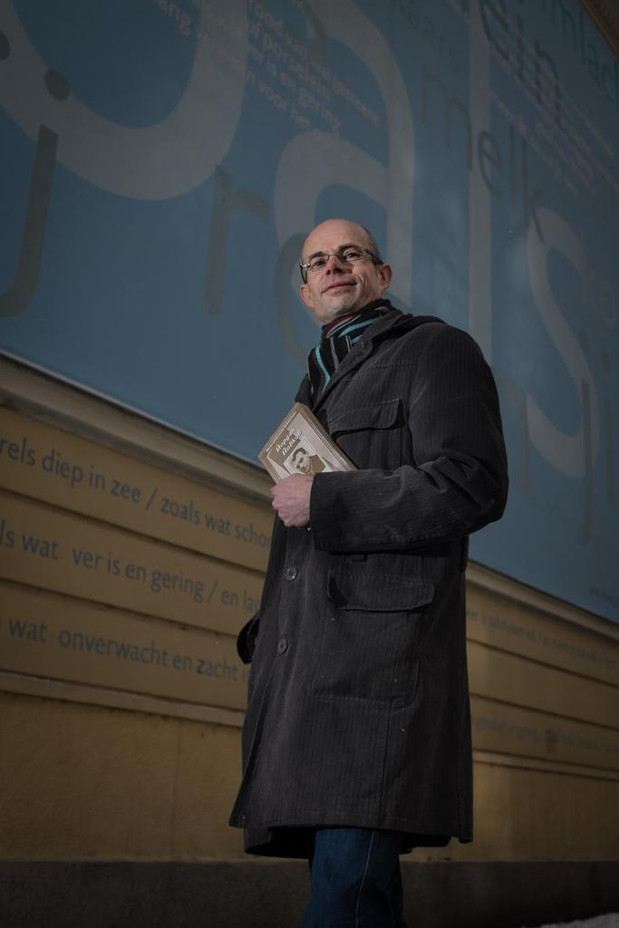
Dirh
van Harten
The Netherlands

Slide 25
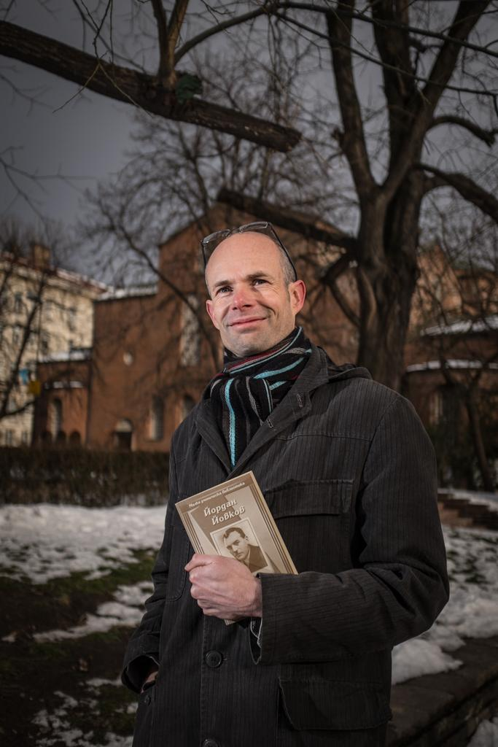

Slide 26
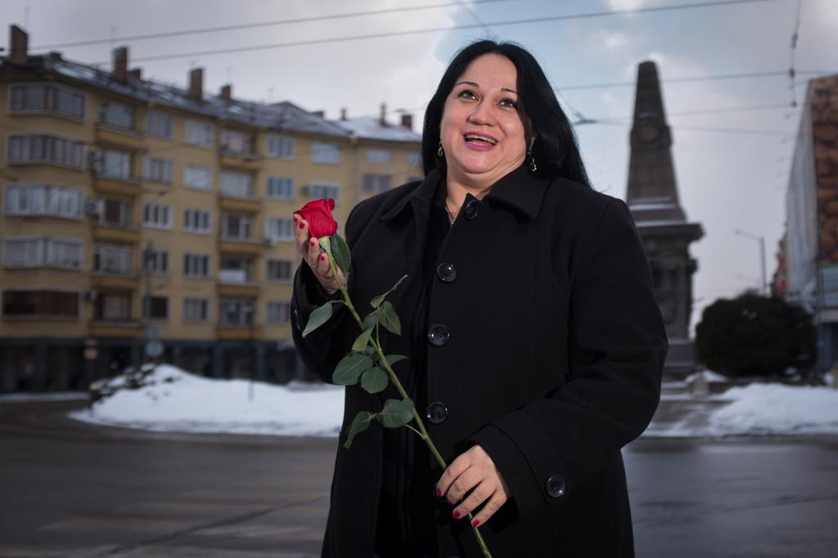
Dzhuli Dzhamil Tatuz
Syria

Slide 27
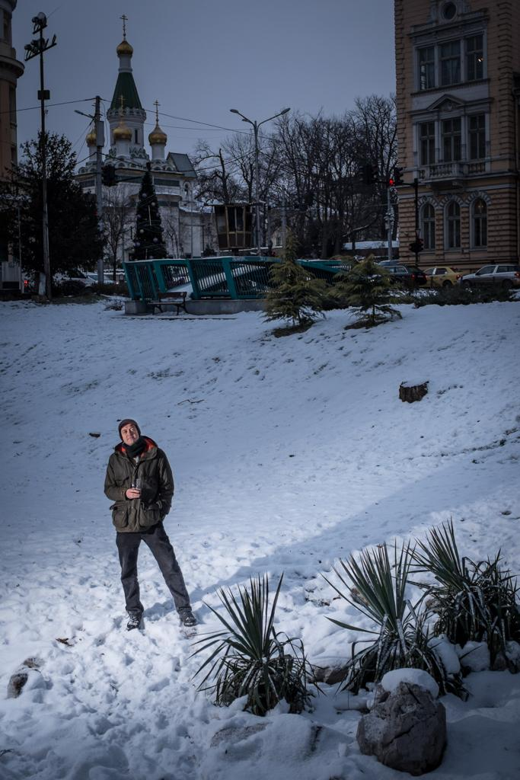
Dmitry Yagodin
Russia

Slide 28
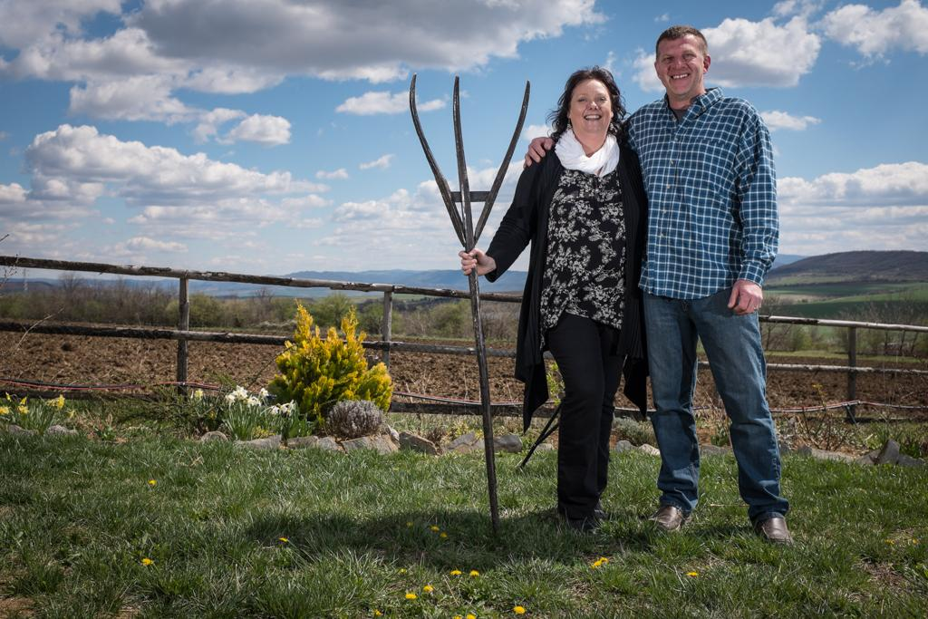
Nicola and Nicholas Kinson
Great Britain

Slide 29
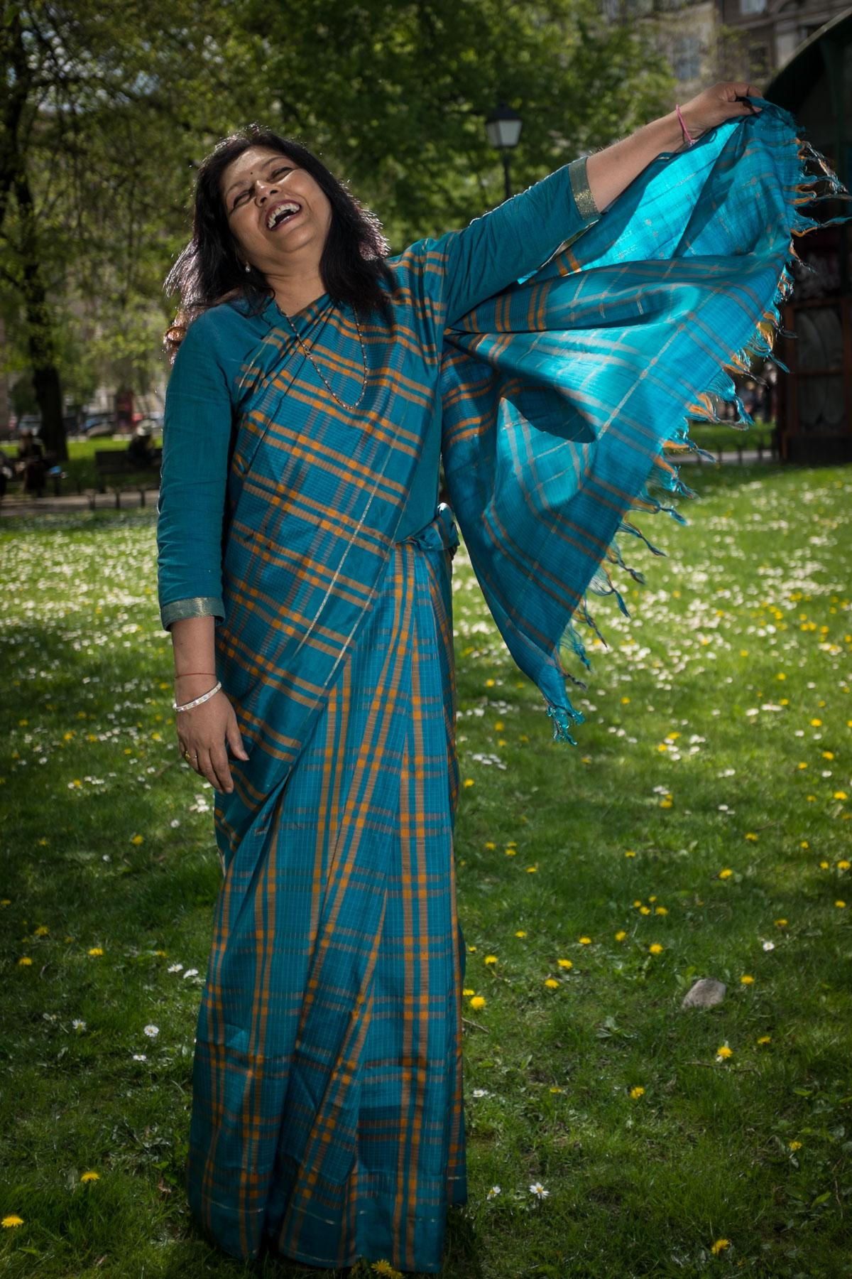
Mona Kaushik
India

Slide 30
The UnBulgarians
Interviews by Dimana Trankova
Field Research by Bistra Ivanova
Photography by Anthony Georgieff

