Slide 1
The gender gap in educational outcomes in Norway
Francesca Borgonovi and Soumaya Maghnouj on behalf of the OECD Review team

Slide 2
Evidence on gender gaps in norway in an international perspective

Slide 3
Long term trends in the gender gap in tertiary attainment
Source: Barro and Lee, 2013.

Slide 4
Share of females among first-time entrants in tertiary education and among first-time tertiary graduates in selected OECD countries (2015)

Slide 5
Completion rate of upper secondary education, by gender (2015)

Slide 6
The evolution of gender gaps in literacy
Gender gaps among the cohort of individuals born between 1990 and 1991 by age period
Note: All gaps for the age groups 10-11 and 15-16 are statistically significant

Slide 7
The evolution of gender gaps in numeracy
Gender gaps among the cohort of individuals born between 1984 and 1985 by age period

Slide 8
Trends in the gender gap in reading among 4th grade students

Slide 9
Trends in the gender gap in mathematics among 4th grade students

Slide 10
Percentage of all-round low-achieving 15-year-old students, by gender in selected countries (2015)

Slide 11
The gender gap in print and digital reading, evidence from PISA 2012

Slide 12
Gender gaps in numeracy scores, by international survey

Slide 13
Gender differences in literacy between PISA and PIAAC

Slide 14
Gender gap in final assessment grades

Slide 15
Relevance of socio-economic disparities
Socio-economic status
School’s socio-economic status
Migrant background

Slide 16
Relevance of attitudinal and behavioural factors
Educational expectations
Effort and motivation
Attitudes towards school and learning

Slide 17
Policies and practices to mitigate or prevent the gender gap in school achievement: an OECD peer-learning review

Slide 18
An OECD peer-learning review
Goal: share examples of policies to help reduce the gender gap in OECD countries
3 peer review countries identified: Finland, the Netherlands and the United States
… and relevant examples from other OECD countries.

Slide 19
The review team and review process
Two OECD analysts: Francesca Borgonovi and Soumaya Maghnouj
Three researchers from the peer-learning countries:
Joscha Legewie, Yale University, USA
Annemarie van Langen, KBA Nijmegen, the Netherlands
Mari-Pauliina Vainikainen, University of Tempere, Finland

Slide 20
The review process
Identification of policy focus based on preliminary results of policy brief
Identification of policy levers and peer-countries based on discussions with the Commission
Stakeholders meeting to consolidate understanding and identify relevant policy examples

Slide 21
State of the debate in the peer review countries
Increased visibility of research on the issue of gender gaps in learning achievement
But limited policy interventions to explicitly mitigate or prevent the gender gap
Increasing focus on inter-connection between gender and education equity dimensions

Slide 22
Choices of policies
Actual or expected effect on improving boys’ achievement
Relevance to Norway
Inclusiveness
Policy evaluation
Scale of the policy

Slide 23
3 levels of policies and practices
System level policies
School level policies and practices
Teaching and learning practices

Slide 24
Teaching and learning practices in the classroom: adapting teaching to students’ needs

Slide 25
Policy lever 1.1: Increasing students’ engagement with reading
Encouraging parents to read with their children
Läs för mej, pappa (Read to me, Daddy) initiative in Sweden
The Bookstart programme in the United Kingdom
Classroom strategies to improve engagement in reading
DEAR programmes
Premier League Reading Stars in England, United Kingdom

Slide 26
Policy example: Premier League Reading Stars in England
Reading intervention for 8 to 13 y/o
10 themes literacy lessons where football stars talk about their favourite book and why they like reading
Guide activities to learn reading methods
Evaluated in 2013: the share of confident readers (increased from half to 80%, highest increase among boys 36pp increase).

Slide 27
Policy lever 1.2: Reducing disruptive behaviours in classrooms
Guidelines and practical tools to help teachers address and prevent disruptive behaviours:
Practice guide to reduce behavioural problems in classrooms in the United States

Slide 28
School level practices and policies to prevent early school leaving among boys

Slide 29
Policy lever 2.1: Early identification of students at risk of dropping out
Preventing truancy
Stricter monitoring of truancy in the Netherlands
Early warning systems
The risk detector platform in Iceland

Slide 30
Policy lever 2.2: Targeted support to students at risk of falling behind in their learning and dropping-out
Multi-tiered interventions
The three tiered support model in Finland
Tutoring and mentoring programmes
Targeted tutoring in Chicago, USA
Becoming A Man, NYC, USA

Slide 31
Policy example: Targeted tutoring in Chicago, USA
Implemented in Chicago in 2012
Individualized mathematics tutoring programme in small group setting ( 2 students per instructor)
27 sessions of one hour of cognitive behavioural therapy: value education, social skills, problem-solving
Evaluation: evaluation in 2014 (Cook et all, 2014): “participation increased math test scores by 0.65 of a control group standard deviation (SD) and 0.48 SD in the national distribution … and seem to have increased expected graduation rates by 14 percentage points.”

Slide 32
Policy lever 2.3: Integrating services to improve learning, students’ well-being and prevent early-school leaving
In-school multi-professional teams
In-school professional teams in Finland
Multi-sectoral coordination
Follow-up and support to early school leavers platforms in France

Slide 33
Policy example: In-school multi-professional teams in Finland
Multi-professional teams embedded in schools: social worker, psychologist, school nurse, special educators.
Teams meet weekly to design and coordinate school-level action and monitor the situation of students well-being and learning in each class and provide comments and advice on individual student learning plans. Teachers and school principal attend the meeting.

Slide 34
System level policies: Transition from early childhood education and care to primary

Slide 35
Policy lever 3.1: Transition from early childhood education and care to primary education
Pedagogical continuity between ECEC and primary school
The Foundation Phase curriculum in Wales, United Kingdom
Transmitting students’ information
Transition templates to share students’ information, Ireland
Transition learning and development statement in Australia
Alternative models for more flexible starting age of primary education
Flexible and modular transition initiatives in the Netherlands

Slide 36
Policy example: Flexible and modular transition initiatives in the Netherlands
Schools in the Netherlands are experimenting with more modular and flexible approaches for organizing the transition of students from ECEC to primary:
Dividing students instruction time between ECEC and primary
Increasing the number of entry points into primary from one to two or more
Combining ECEC and first grade of primary in one grade

Slide 37
System level policies: providing incentives to policy-makers and schools to build and disseminate evidence

Slide 38
Policy lever 4.1: Encouraging evidence-based policies at local and school level
Encouraging evidence-based policies at local and school level
What Works Clearinghouse in the United States
Education Endowement Fund in the United Kingdom

Slide 39
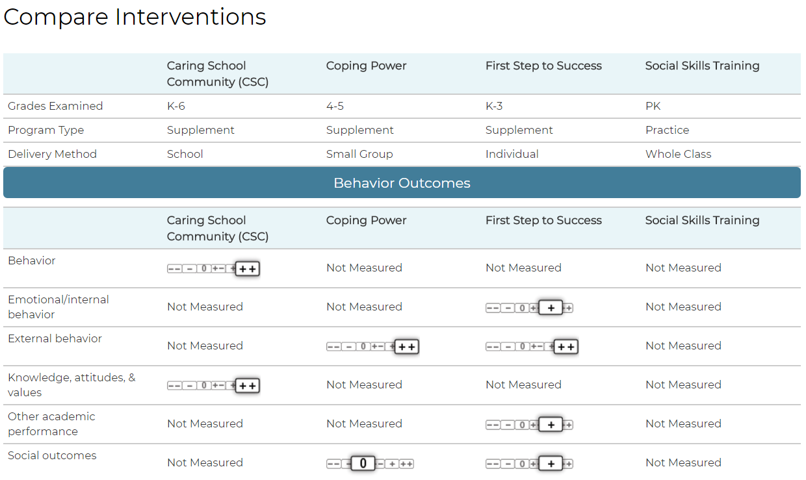
Policy example: What works clearinghouse in the United States
Notes:
Link if you want to show it live: https://ies.ed.gov/ncee/wwc/FWW/CompareInterventions?selinterventions=[{%22id%22:%22103%22,%22match%22:-1},{%22id%22:%22752%22,%22match%22:-1},{%22id%22:%22767%22,%22match%22:-1},{%22id%22:%22763%22,%22match%22:-1},{%22id%22:%22208%22,%22match%22:-1},{%22id%22:%22252%22,%22match%22:-1}]

Slide 40
Policy lever 4.2: Targeted funding to reduce the gender gap
My Brother’s Keeper challenge in the United States
State funding to promote equity in Finland
Pupil premium in England, United Kingdom

Slide 41
Policy example: My Brother’s Keeper in the United States
Federal grant to schools, local communities and States to improve school and labour outcomes of boys and young men of colour. 6 areas of intervention:
1- Entering school ready to learn;
2- Reading at grade level by third grade;
3- Graduating from high school ready for college and career;
4- Completing postsecondary education or training;
5- Successfully entering the workforce; and
6- Reducing violence and providing a second chance to justice-involved youth.
Evaluation: 250 communities in all the US, 600 million USD raised from private sector.

Slide 42
Policy 4.3: Addressing information gaps
Assessment and the nature of the gender gap
Differences in results between PISA and PIAAC
Information about cognitive and socio-emotional development in early years
The Early Development Instrument (EDI) in Canada and Australia
The OECD International Early Learning and Child Well-Being Study

Slide 43
Concluding remarks
Policy-making to reduce the gender gap in school outcomes is at its infancy
Importance of designing policy intervention and evaluating them in national context
Address the main evidence gaps

Slide 44
THANK YOU!
Link to the full report: https://doi.org/10.1787/f8ef1489-en
Contact info:
Francesca.borgonovi@oecd.org
Soumaya.maghnouj@oecd.org
To learn more about our work: http://www.oecd.org/education/school/strength-through-diversity.htm

